Slide 1
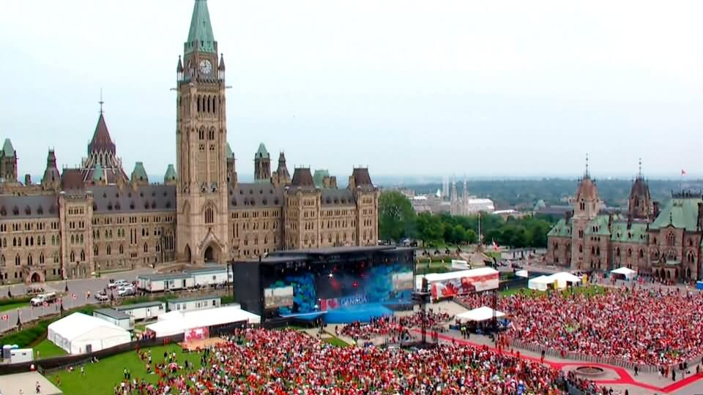
Reporting on Canada’s Cultural Mosaic
New Canadian Media
Guide for Immigrant Journalists
— Judy Trinh, Broadcaster and Writer

Slide 2
New Canadian Media
We amplify the voices of the nearly 8 million people in Canada who are immigrants.
Our goal is to report on the concerns of diverse communities and enrich our journalism with their cultural voices.

Slide 3
Starting Points
The goal is always truth and accuracy
How will you make people care?
Inform, educate and motivate
Hold power accountable
Report barriers and challenges
Provide context and nuance
Push back against stereotypes
The Principles of Ethical Journalism

Slide 4
Use your advantage
Seek out diverse voices from all socio-economic backgrounds
Interview men and women
Use connections from your diaspora
Get better interviews, deeper insight and more access

Slide 5
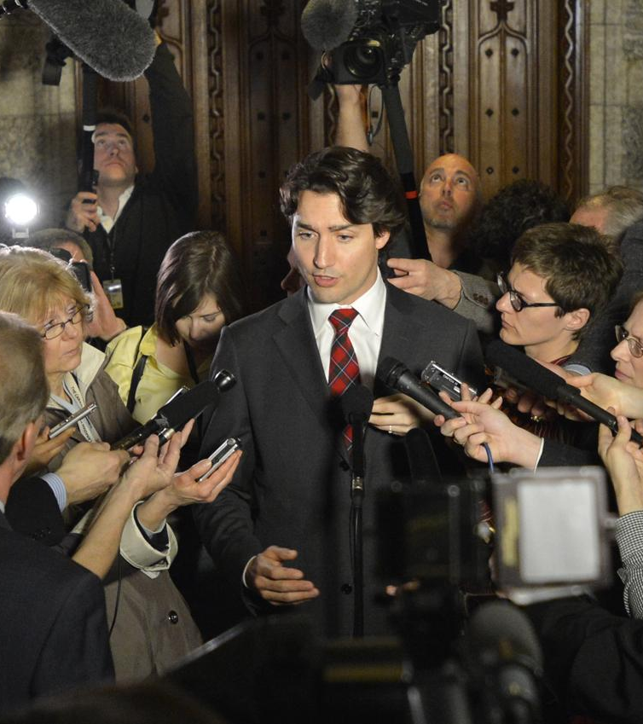
Reporting the News
Report facts
Answer basic questions
Dig deeper for details
Be fair, seek multiple perspectives
Ascertain and explain what’s behind people’s quotes and opinions
Provide context
Name sources
Seek accountability
Journalistic Standards and Practices (JSP)

Slide 6
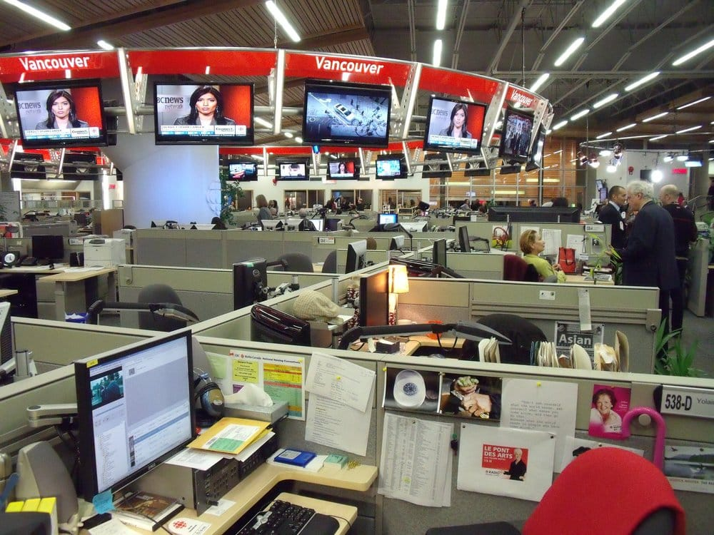
Reporting the News
Be critical, analytical
No racist or discriminatory opinions
Use neutral language
Verify social media posts
Double source
Be accurate

Slide 7
Beware of False Equivalence
Being fair and balanced, does not mean giving fringe beliefs the same profile as proven fact. It also does not mean giving harmful, racist, discriminatory and opinion without evidence, a platform in the interest of showing “both sides.”
Examples:
Nail in the coffin for “both sides” journalism
Why is false equivalence so dangerous?

Slide 8
Photos
and
Videos
You can’t be heard if you’re not seen
Photos/ footage should have context, show surroundings
Setting should be relevant to your article
Face should reflect the mood of the story
Horizontal alignment

Slide 9
The Art of the
Interview
Set your goals: seek info, accountability, reveal something personal
Prepare: research your subject and who you’re interviewing
Break the ice, develop rapport
Start with an easy question then follow up for more detailed answers
Don’t shy away from tough questions
Be sensitive when asking personal questions
Seek emotional responses
Columbia Journalism Review
Contently: 5 Reporter Tips

Slide 10
Journalism Sources
In a time when news media is under attack as “fake news” it is imperative that our interview subjects go on the record.
Naming our sources bolsters our credibility.
Attribution upholds our mandate of elevating immigrant voices.
You can’t change things by being invisible.

Slide 11
Confidential Sources
Allowed when naming the person could endanger them
Anonymity to victims of sexual crime
To protect identity of a minor
Whistleblower
A deep source not authorized to speak
Must get editorial approval
Examples:
New York Times Discussion of Anonymous sources

Slide 12
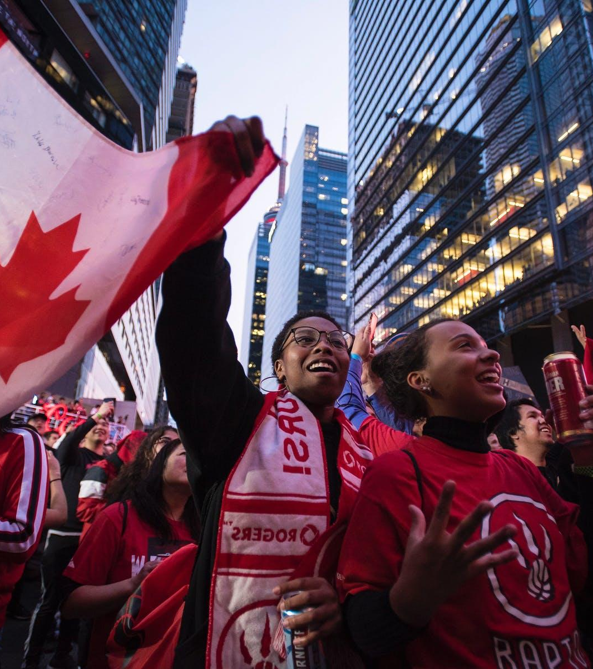
Snapshot of Canada
320,000 permanent residents welcomed in 2018
60% Economic class
49,000 refugees, protected persons
Top 5: India, Philippines, China, Syria, United States
360,000 annually immigrants by 2022
Source: 2019 Parliamentary Report

Slide 13
Terminology
There is cultural and religious diversity within ethnicities and immigrant groups
Be precise in your language to avoid stereotypes
Ask for preference

Slide 14
Understand
Your
Audience
Economic class immigrants
Accounts for 60% of permanent residents
Accepted on points basis
Highly trained professionals
Skilled workers
Family class immigrants
Sponsored by Canadian Citizen
Financially support parents/grandparents for 20yrs
Support partner for 3 yrs, child for 10yrs
Family class immigrants
Migrants
Refugees
Asylum seekers
Statelessness

Slide 15
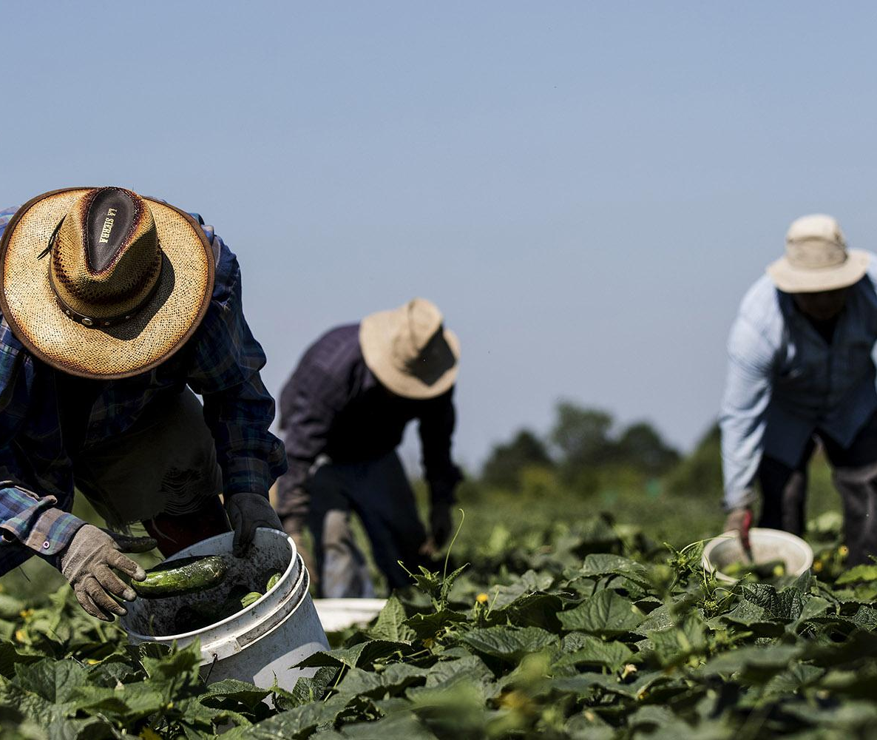
Migrants
A general term that refers to individuals who move from one region to another.
Migrant workers apply to people hired under Canada’s temporary foreign worker program: nannies, farm staff.
Can be used in reference to refugees and asylum seekers.

Slide 16
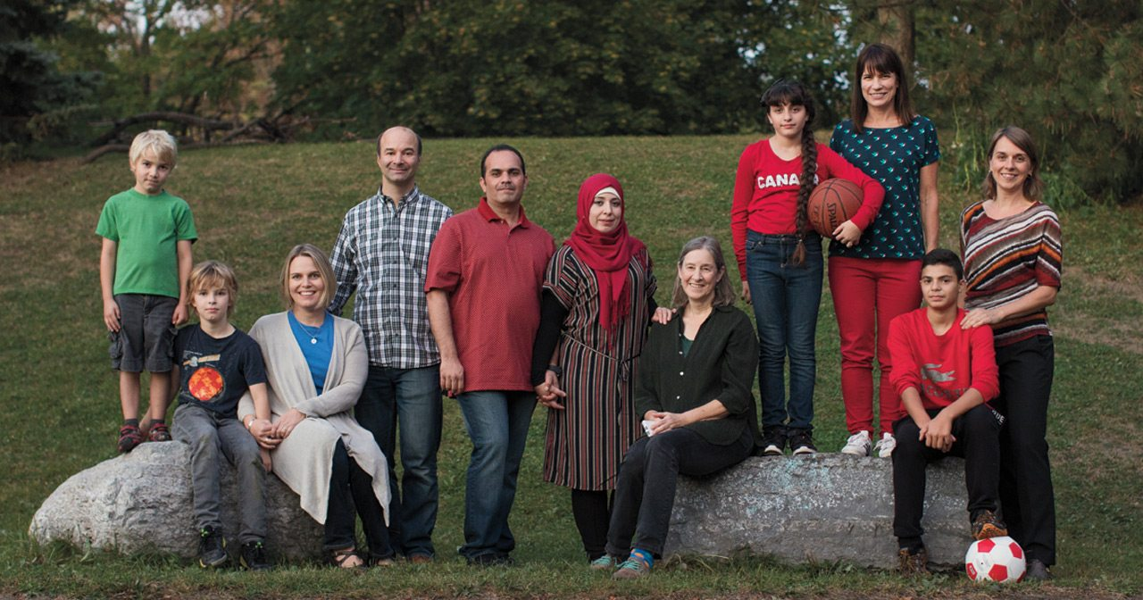
Refugees
Forced to flee from conflict or persecution
26 million refugees worldwide
Frame reporting based on shared humanity
And fundamental human rights
UNHCR Fact Sheet
Photo: Remi Theriault

Slide 17
Asylum seekers
Someone requesting sanctuary
Crossed borders
Waiting to be processed
Waiting for a hearing

Slide 18
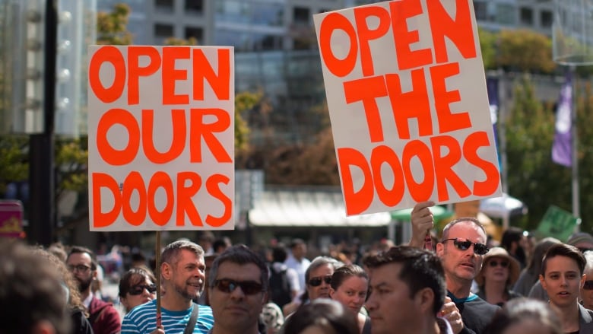
Tips for Reporting
Refrain from broad strokes
Facts, precise terms, neutral language
Focus on shared humanity and common goals
Push back on “us vs. them” narrative

Slide 19
Dispelling Myths
Canada has welcomed more than 1,000,000 refugees since 1980
Refugees unemployment rate is similar to Canadian average (9% vs. 6%, equals out after 5 years)
Refugees join middle class within 5 years of arrival ($45K-$80K)
14.5% of refugees become business owners who employ others
UNHCR Canada Report 2019

Slide 20
Making
Canada
Great
>50% have a Bachelor’s degree or higher
41% second generation graduate university compared to 24%
87% employment rate similar to Canadian population
32% volunteer
61% belong to social organizations
86% become Canadian Citizens

Slide 21
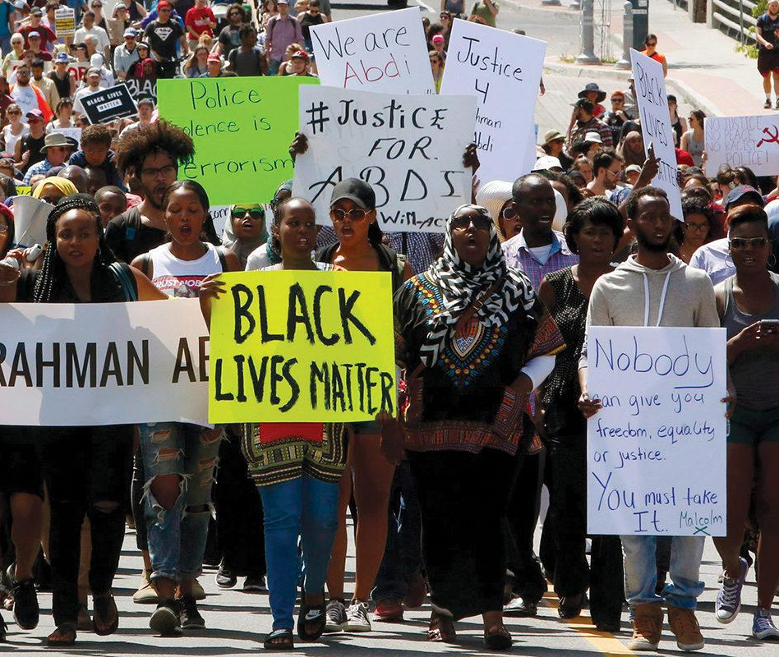
Race Relations
Acknowledge discrimination based on race and ethnicity exists.
Who has experienced racism:
54% Black Canadians
53% Indigenous
38% South Asian
36% Chinese
8/10 people say Canada has good race relations.
Environics Race Relations 2019 Study

Slide 22
Diversity is our Strength
2035: visible minorities will be 35% of Canada’s population
70% say Canada is open and welcoming
Seek out diverse voices
Change the narrative, one story at a time

Slide 23
Examples
of
Good Journalism
How Canadian Media Covers Immigration And Refugees:
CBC: Brazilian refugee smuggled to Canada
Toronto Star: Canada agrees not to deport ICU during pandemic
BBC: Iran Plane Crash
CBC: Canada’s Victims of Flight PS752
National Post: Integrity of Canada’s immigration system damaged
CBC: Illegal immigration scheme in Atlantic Canada

Slide 24
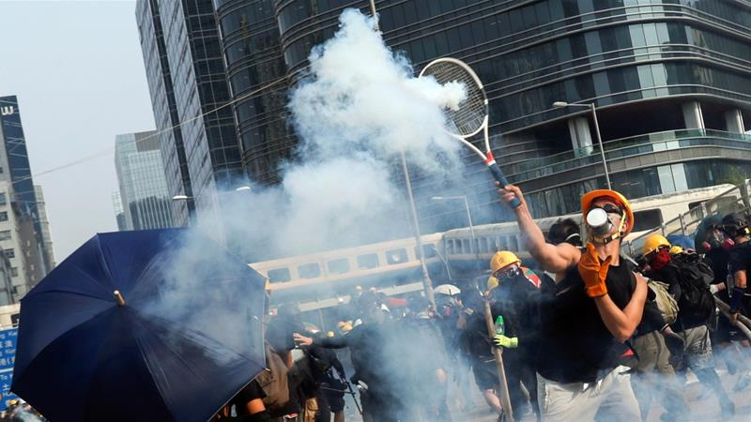
“Journalism can never be silent: that is its greatest virtue and its greatest fault. It must speak and speak immediately, while the echoes of wonder, the claims of triumph and the signs of horror are still in the air.”
— Henry Anatole Grunwald

